Slide 1
Electronics Bay
and Payload

Slide 2
Overview and Goals
Goal: To select and configure all electrical components to be used during launch and engine testing as well as to develop the payload.
Accomplishments: Picked out sensors to be used in engine testing and launch, constructed circuit diagram for launch electronics, and secured payload idea.
Work to be done: Order components, begin developing electronics for engine testing, write BBB code, prototype and build launch circuitry, finish detailed Solidworks design.
Overview
Electronics & Payload

Slide 3
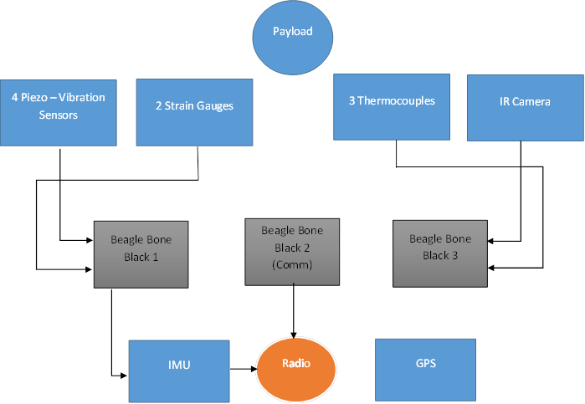
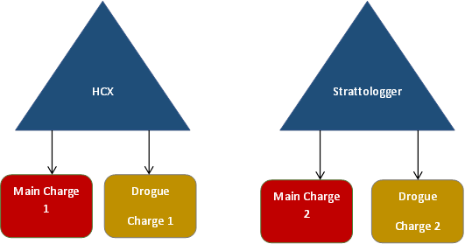
Blackbox Diagram
Overview
Electronics & Payload

Slide 4
Total Weight of Electronics and Payload
Projected weight of electronics: 6.36 lbs
CubeSat & P-POD: 6.4 lbs
Combined: 12.76 lbs
Component | Quantity | Weight (lb)
BeagleBone | 3 | 0.245
Voltage Regulator | 4 | ------
IMU | 1 | 0.015
Xbee radio | 1 | 0.018
Xbee Explorer | 1 | 0.0125
radio antenna | 1 | 0.03
Thermocouple K-type (low) | 1 | 0.016
Thermocouple K-type (med) | 1 | 0.02
Thermocouple K-type (high) | 1 | 0.02
Thermocouple amplifier | 3 | 0.009
piezo-vibration | 4 | 0.005
strain gauge | 2 | 0.0006
IR camera | 1 | 0.078
Breakout Box | 1 | ------
hardware/shelves | 1 | 2.5
Battery | 1 | 3.25
Strattologger | 1 | 0.028
G-WIZ HCX | 1 | 0.112
Beeline GPS | 1 | 0.125 (w/ battery?)
2U CubeSat and P-pod | 1 | 6.4
 | Total | 12.76
Electronics Bay
Electronics & Payload

Slide 5
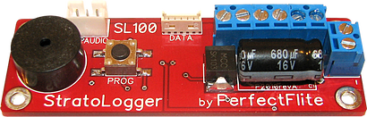
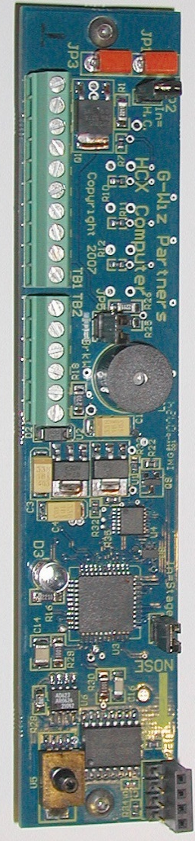
Flight Computers
G-Wiz
Uses accelerometer and barometric altitude measurement
Stores flight data to a Micro SD card
Four programmable pyros
Fire at apogee or specified altitude
Stratologger
Two programmable pyros
Altitude adjustable
Collects altitude, temperature, battery voltage data at 20 samples per second
Price: $79.95
Electronics Bay
Electronics & Payload

Slide 6
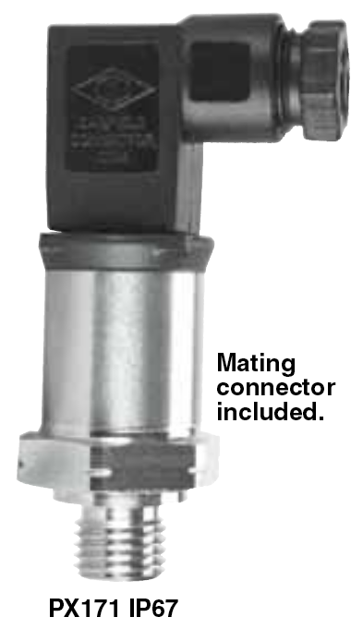
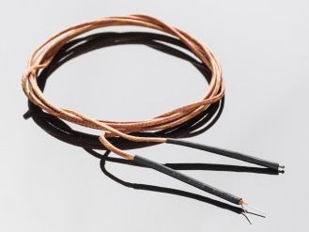
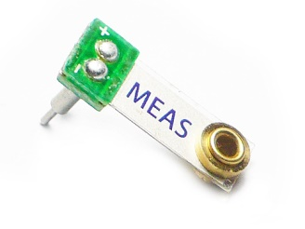
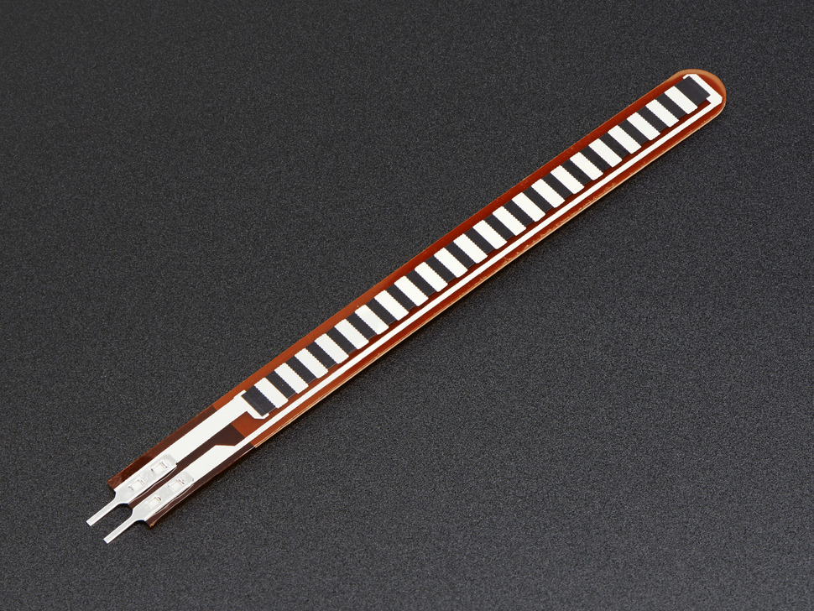
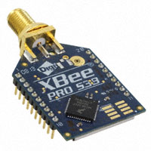

Sensor Selection
Glass braid insulated Thermocouples and MAX31855 Amplifiers
Minisense 100 piezo-vibration sensor
Short Flex/Bend Sensor
XBee Pro 900 RPSMA Radio + Antenna System
Tamarisk 320 Infrared Camera
PX171-2.0KSG Pressure Transducer
Electronics Bay
Electronics & Payload

Slide 7
Microcontroller Selection
Microcontroller
BeagleBone Black
Language
Python
Integrated Development Environment
Pycharm
Notepad ++
Coding Goals
Sending sensor data to ground
Collecting and storing payload data
Electronics
Electronics & Payload

Slide 8
Power Needs
Sensor | Voltage draw (each) | Amp draw (each) | Total Power (max) | For Flight or Test | Quantity
Thermocouple | 3.3 V | Negligible | N/A | Both | 3
IMU | 3.3 V | 3.6-6.5 mA | 21.5 mW | Flight | 1
Strain Gauge | 5 V | 0.1 A | 1 W (0.5 W ea.) | Flight | 2
Piezovibration | None | Negligible | N/A | Flight | 4
Radio | 3.3 V | 210 mA | 693 mW | Flight | 1
Pressure Transducer | 12 V | 10 mA | 120 mW | Testing | 2
IR Module | 5-5.5 V | 1-1.2 A | 5-6.6 W | Flight | 1
BeagleBone | 5 V | 1 A | 15 W (5 W ea.) | Flight | 3
Total (in-flight): | - | 4.73 A | 23.43 W | - | 13
Electronics Bay
Electronics & Payload

Slide 9
Battery Selection
Considerations
High heat:
Batteries store energy in chemical solutions, which are susceptible to breaking down in heat
Confined Space:
Rocket diameter: 6.5 in
Vertical space allocation for electronics: 18 in
Candidates:
Nickel Cadmium
Pros: good energy density (21.3 Wh/lb)
Cons: very expensive ($1.76/Wh)
Highest heat tolerance
Lead Acid
Pros: cheap ($0.34/Wh)
Cons: heavy/large (15.4 Wh/lb)
Lowest heat tolerance
Lithium-Iron Phosphate
Pros: high energy density (50.8 Wh/lb)
Cons: expensive ($1.40/Wh)
Good heat tolerance
Electronics Bay
Electronics & Payload

Slide 10
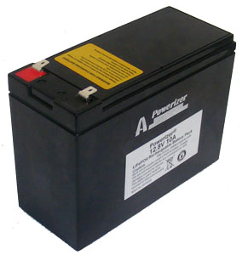
Final Decision
Lithium-iron phosphate
Meets power and size requirements
Goal: two hours of power
Specifications:
Dimensions: 5.94” (151mm) x 2.6” (65mm) x 4.65” (118mm )
Weight: 3.25 lbs
Cost: $140
Voltage: 12.8 V
Amperage: 10 Ah (40 A peak)
Power Capacity: 120 Wh
Electronics Bay
Electronics & Payload

Slide 11
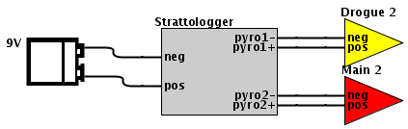
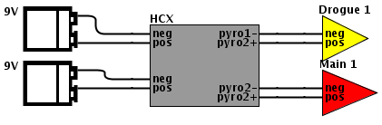
Critical Flight Operations - Parachute Deployment
All independent power supplies
If one fails, system is not compromised
Independent charge activation
Each flight computer is independently attached to the charges
Charges are to be black powder canisters with e-match detonation
Two charges will be used
Required in rules
Pressure Equalization
General rule: One ¼ in hole per 100 in³
Our calculations: 6.5 in diameter, 24 in long, 368 in³
Electronics Bay
Electronics & Payload

Slide 12
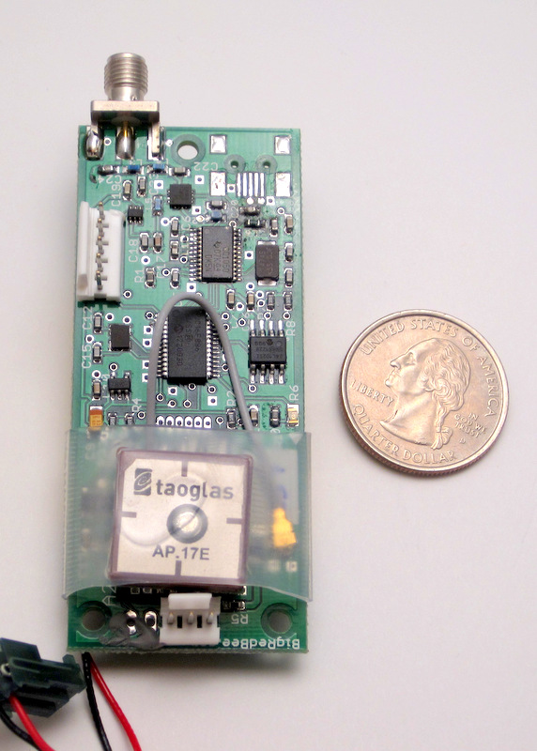
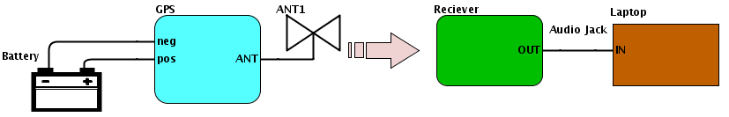
Critical Flight Operations - Tracking
How it will work:
GPS module transmits signal
Signal received with handheld VHF radio
Radio receiver is connected to a laptop via 3.5 mm audio jack
Laptop with free packet decoding software is used to process the signal and translate the information
Features:
Unused module from last year
20 mile line-of-sight range
Adjustable sampling rate
Transmits/stores position, course, speed
Power:
Lithium-polymer battery included
Will be replaced with Nickel-Cadmium
Electronics Bay
Electronics & Payload

Slide 13
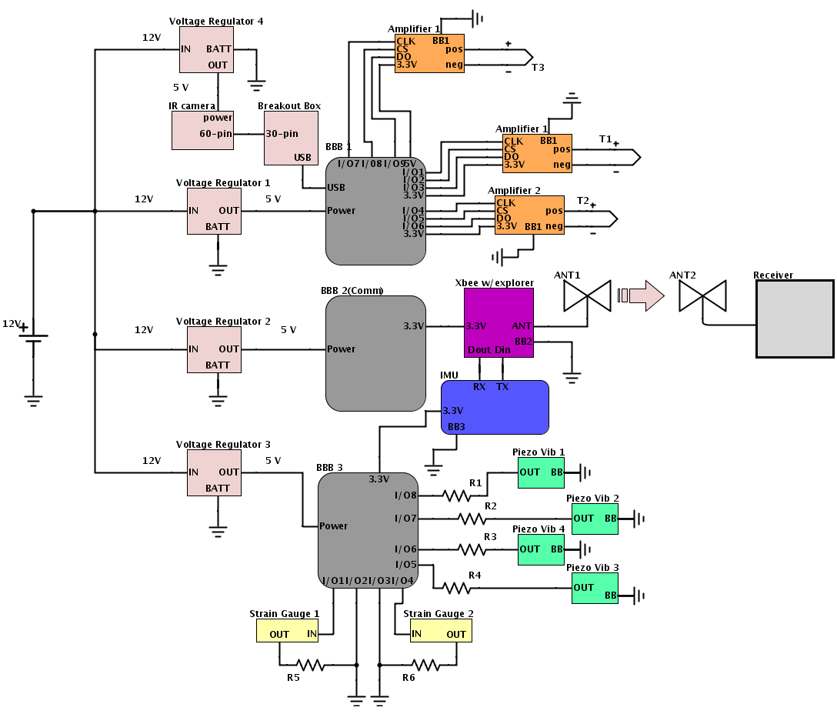
Circuit Design of Sensor Package
Independent of critical functions
3 microcontrollers
2 Data processing
1 Communication
Several intermediate circuits
Abiding by competition rules
Conceptual Design
Electronics & Payload

Slide 14
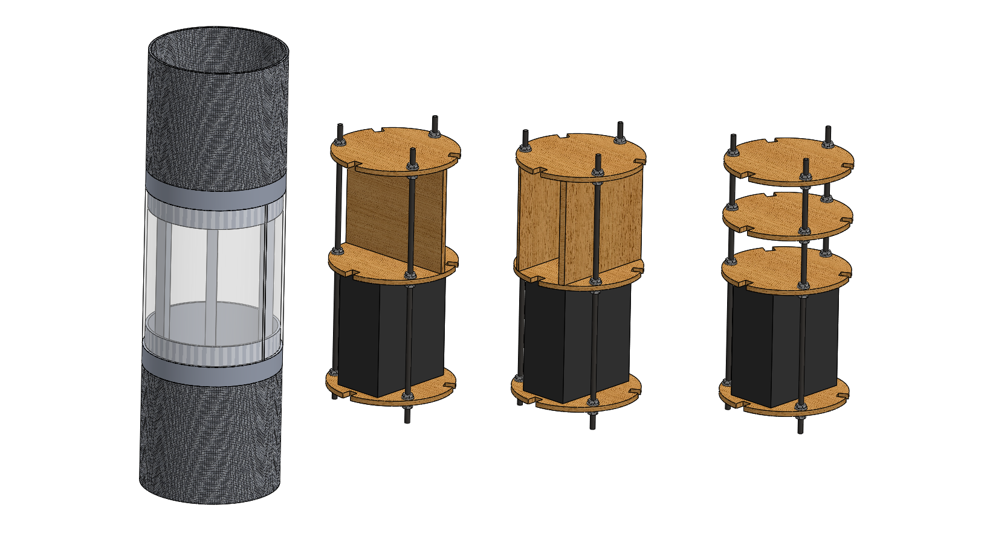
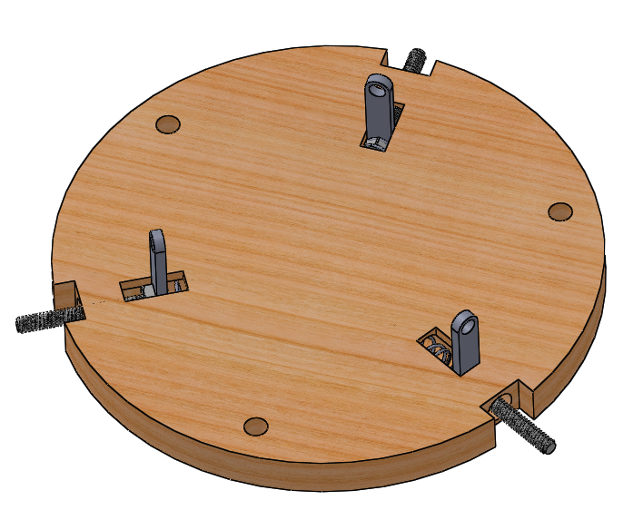
Electronics Bay Assembly
Conceptual Design
Hard plywood machined to create mounting surfaces, section cutouts for wiring
3 threaded rods along perimeter of platforms, locknuts secure each platform
Main battery secured to lower level
Other components secured to upper level
Details being analyzed
Best configuration of upper mounting surface
Securing assembly to rocket body
Spring-pin system, rod hangers, clamps/brackets
Detailed analysis of load limit
Conceptual Design
Electronics & Payload

Slide 15
Payload
Requirements:
10 lbs., removable, scientific value
Quality design, technical relevance, external sponsor (optional)
Dr. Xiaofeng Wu from University of Sydney
Student team designing/building custom made 2U CubeSat and P-POD
CubeSat is 3D printed ~2.43 lbs., contained in P-POD ~3.97 lbs.
Collaborate with Dr. Wu’s team to field test CubeSat design
Assess structural integrity to withstand vibration, temperature, etc.
Possible communication system testing
An array of sensors will be used to characterize the flight environment
Entire payload is considered the CubeSat, P-POD and all electronic support (sensors, batteries, etc.)
Total weight expected to be 12.88 lbs.
Payload Selection
Electronics & Payload

